Slide 1
Chapter Four
Input/Output Device Management

Slide 2
Input/Output (I/O) Device Management
Input/Output (I/O) Device Management is a critical aspect of operating systems that deals with the communication and control of input and output devices in a computer system.
It consists of device drivers, I/O controllers, interrupt handlers, and the kernel, working together to manage data transfer between the computer and external devices.

Slide 3
Function and Structure of I/O System
Function
The I/O system is responsible for managing the flow of data between the computer and its external devices, such as keyboards, monitors, disk drives, and network interfaces.
Structure
The I/O system typically consists of a set of components, including device drivers, interrupt handlers, I/O controllers, and the kernel. These components work together to facilitate efficient and reliable communication between the CPU and I/O devices.

Slide 4
Structure
The structure of an Input/Output (I/O) system in a computer involves various components working together to manage communication between the central processing unit (CPU) and peripheral devices. The key elements within the structure of an I/O system are:
User-Level I/O Software:
This layer includes libraries and APIs (Application Programming Interfaces) that application programs use to interact with I/O devices.
It provides a high-level, device-independent interface for application developers, allowing them to perform I/O operations without dealing with low-level hardware details.

Slide 5
Device-Independent Operating System Kernel
This layer acts as an intermediary between user-level software and device drivers, providing a standardized interface for different devices.
It abstracts the hardware details, ensuring that applications can issue I/O requests in a device-independent manner. It manages I/O requests and forwards them to appropriate device drivers.
Device Drivers
Device drivers are specialized software components that facilitate communication between the operating system kernel and specific hardware devices.
Each device driver is tailored to a particular device type and handles the translation of generic commands from the operating system into instructions that the device can understand.

Slide 6
I/O Controllers
I/O controllers are hardware components responsible for managing the physical communication between the CPU and peripheral devices. Examples: Disk controllers, network interface controllers, USB controllers, etc.
They handle low-level details of data transfer, protocol conversion, and signal processing specific to the attached devices.
Interrupt Handlers
Interrupt handlers are software routines that manage interrupts generated by devices to signal events.
When an interrupt occurs, the interrupt handler takes control, processes the interrupt, and initiates the necessary actions, such as notifying the operating system about completed I/O operations.

Slide 7
I/O Bus
The I/O bus is a communication pathway that connects the CPU, memory, I/O controllers, and other system components. Examples are: PCI (Peripheral Component Interconnect), USB (Universal Serial Bus), SATA (Serial ATA), etc.
It provides a physical connection for data transfer between the CPU, memory, and I/O devices.
Direct Memory Access (DMA) Controller
The DMA controller allows certain devices to transfer data directly to and from system memory without involving the CPU.
DMA enhances overall system performance by reducing CPU overhead in data transfer operations.
Memory-Mapped I/O
Memory-mapped I/O is a technique where I/O devices are treated as if they were memory locations.
It simplifies the interface between the CPU and devices, making it easier to read and write data by treating devices as if they were part of the memory space.

Slide 8
Device drivers
Device drivers are software modules that can be plugged into an OS to handle a particular device. Operating System takes help from device drivers to handle all I/O devices.
Device drivers are specialized software components that allow the operating system to communicate with and control specific hardware devices.
Windows: In Windows, device drivers are typically written in C or C++. The Windows Driver Model (WDM) is a framework that facilitates the development of drivers for Windows operating systems.
Linux: Linux uses a modular approach for device drivers. They can be dynamically loaded and unloaded from the kernel. The Linux kernel provides a framework for driver development, and drivers can be written in C.

Slide 9
Functions of Device Drivers
Initialization and Configuration: Device drivers initialize and configure hardware devices during system startup.
Data Transfer: They manage the transfer of data between the CPU, memory, and the connected hardware device.
Interrupt Handling: Device drivers handle interrupts generated by devices to signal events such as completed data transfers or errors.
Error Handling: Device drivers are responsible for detecting and managing errors that may occur during device operations.
Power Management: In many cases, device drivers also play a role in power management, helping the OS control the power states of devices to conserve energy.

Slide 10
Types of Device Drivers
Character Drivers: Manage devices that transfer data as a stream of characters, such as keyboards or mice.
Block Drivers: Handle devices that store and retrieve data in fixed-size blocks, like hard drives and solid-state drives.
Network Drivers: Control network interfaces for communication over a network.
Graphics Drivers: Manage graphical display devices, such as graphics cards and monitors.
USB Drivers: Handle devices connected through the Universal Serial Bus (USB).
Printer Drivers: Facilitate communication between the OS and printers.

Slide 11
Device Driver Architecture
Kernel-Mode Drivers: These drivers run in privileged mode within the kernel of the operating system, with direct access to hardware resources. They are critical for managing low-level hardware interactions.
User-Mode Drivers: Some drivers run in user mode and communicate with the kernel-mode drivers. This architecture enhances system stability, as issues in user-mode drivers are less likely to crash the entire system.

Slide 12
Development and Installation
Device drivers are typically written in low-level languages like C or C++.
During the installation of a new hardware device, the appropriate device driver must be installed to ensure proper communication between the device and the OS.
Dynamic Loading and Unloading:
Dynamic Loading: Many modern operating systems allow for the dynamic loading and unloading of device drivers, enabling efficient use of system resources.
Plug and Play: The concept of plug and play relies on the ability to dynamically load and unload device drivers when new hardware devices are connected or disconnected.

Slide 13
Device management
One of the important jobs of an Operating System is to manage various I/O devices including mouse, keyboards, touch pad, disk drives, display adapters, USB devices, Bit-mapped screen, LED, Analog-to-digital converter, On/off switch, network connections, audio I/O, printers etc.
An I/O system is required to take an application I/O request and send it to the physical device, then take whatever response comes back from the device and send it to the application.

Slide 14
Categories of I/O devices
I/O devices can be divided into two categories −
Block devices − A block device is one with which the driver communicates by sending entire blocks of data. For example, Hard disks, USB cameras, Disk-On-Key etc.
Character devices − A character device is one with which the driver communicates by sending and receiving single characters (bytes, octets). For example, serial ports, parallel ports, sounds cards etc.

Slide 15
Device Controllers
The Device Controller works like an interface between a device and a device driver. I/O units (Keyboard, mouse, printer, etc.) typically consist of a mechanical component and an electronic component where electronic component is called the device controller.
They manage the actual data transfer and often include specialized hardware to handle specific types of devices.
Examples
Disk controllers, network interface controllers, USB controllers, etc.
Notes:
There is always a device controller and a device driver for each device to communicate with the Operating Systems. A device controller may be able to handle multiple devices. As an interface its main task is to convert serial bit stream to block of bytes, perform error correction as necessary.
Any device connected to the computer is connected by a plug and socket, and the socket is connected to a device controller. Following is a model for connecting the CPU, memory, controllers, and I/O devices where CPU and device controllers all use a common bus for communication.

Slide 16
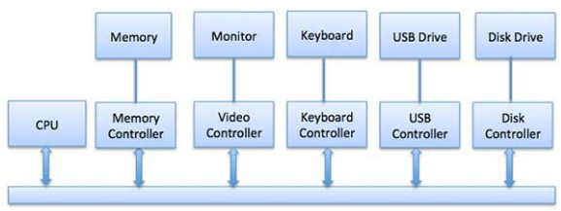
Device controllers

Slide 17
Synchronous vs asynchronous I/O
Synchronous I/O − In this scheme CPU execution waits while I/O proceeds
Asynchronous I/O − I/O proceeds concurrently with CPU execution
Communication to I/O Devices
The CPU must have a way to pass information to and from an I/O device. There are three approaches available to communicate with the CPU and Device.
Special Instruction I/O
Memory-mapped I/O
Direct memory access (DMA)

Slide 18
Special Instruction I/O
This uses CPU instructions that are specifically made for controlling I/O devices. These instructions typically allow data to be sent to an I/O device or read from an I/O device.
Memory-mapped I/O
When using memory-mapped I/O, the same address space is shared by memory and I/O devices. The device is connected directly to certain main memory locations so that I/O device can transfer block of data to/from memory without going through CPU.

Slide 19
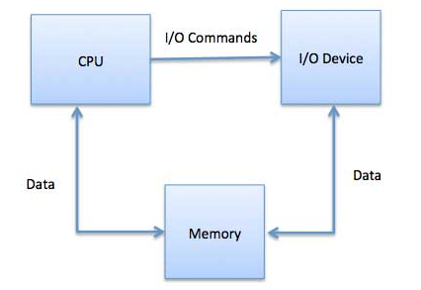
Cont’d

Slide 20
Cont’d
While using memory mapped IO, OS allocates buffer in memory and informs I/O device to use that buffer to send data to the CPU. I/O device operates asynchronously with CPU, interrupts CPU when finished.
The advantage to this method is that every instruction which can access memory can be used to manipulate an I/O device. Memory mapped IO is used for most high-speed I/O devices like disks, communication interfaces.

Slide 21
Direct Memory Access (DMA)
DMA is a technique that allows peripherals to transfer data directly to and from memory without involving the CPU.
This improves overall system performance by reducing CPU involvement in data transfer operations.

Slide 22
Direct Memory Access (DMA)
Slow devices like keyboards will generate an interrupt to the main CPU after each byte is transferred. If a fast device such as a disk generated an interrupt for each byte, the operating system would spend most of its time handling these interrupts. So a typical computer uses direct memory access (DMA) hardware to reduce this overhead.
Direct Memory Access (DMA) means CPU grants I/O module authority to read from or write to memory without involvement. DMA module itself controls exchange of data between main memory and the I/O device. CPU is only involved at the beginning and end of the transfer and interrupted only after entire block has been transferred.
Direct Memory Access needs a special hardware called DMA controller (DMAC) that manages the data transfers and arbitrates access to the system bus. The controllers are programmed with source and destination pointers (where to read/write the data), counters to track the number of transferred bytes, and settings, which includes I/O and memory types, interrupts and states for the CPU cycles.

Slide 23
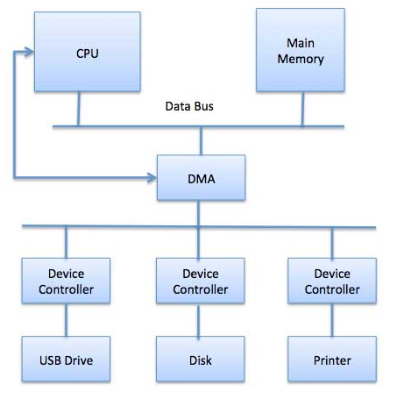
DMA

Slide 24
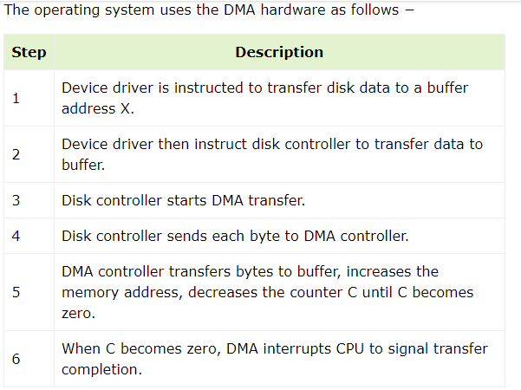
DMA

Slide 25
Polling vs Interrupts I/O
A computer must have a way of detecting the arrival of any type of input. There are two ways that this can happen, known as polling and interrupts.
Both of these techniques allow the processor to deal with events that can happen at any time and that are not related to the process it is currently running.

Slide 26
Polling I/O
Polling is the process of periodically checking status of the device to see if it is time for the next I/O operation. The I/O device simply puts the information in a Status register, and the processor must come and get the information.
Most of the time, devices will not require attention and when one does it will have to wait until it is next interrogated by the polling program. This is an inefficient method and much of the processors time is wasted on unnecessary polls.
Compare this method to a teacher continually asking every student in a class, one after another, if they need help. Obviously the more efficient method would be for a student to inform the teacher whenever they require assistance.

Slide 27
Interrupts I/O
An alternative scheme for dealing with I/O is the interrupt-driven method. An interrupt is a signal to the microprocessor from a device that requires attention.
A device controller puts an interrupt signal on the bus when it needs CPU’s attention when CPU receives an interrupt, It saves its current state and invokes the appropriate interrupt handler using the interrupt vector (addresses of OS routines to handle various events). When the interrupting device has been dealt with, the CPU continues with its original task as if it had never been interrupted.

Slide 28
Buffering
Buffering involves temporarily storing data in a buffer before it is transferred between devices.
This helps in managing speed mismatches between devices and provides a more efficient data transfer mechanism.
A buffer is a temporary storage area that holds data during the transfer of information between two locations, such as between devices with different speeds or capabilities.

Slide 29
Purpose of Buffers
Buffers are used to mitigate differences in data processing speeds between different components of a system.
They help ensure smooth and continuous data flow.
NOTE
Understanding and implementing effective buffer management is crucial for optimizing data transfer, minimizing latency, and ensuring the efficient operation of various components within a computer system.

Slide 30
Types of Buffers
Input Buffer: Temporarily stores incoming data before it is processed by the receiving device or system.
Output Buffer: Temporarily stores data before it is transmitted to an external destination. This allows the output device to operate independently of the input speed.

Slide 31
Functions of Buffers
Flow Control: Buffers help manage the flow of data between devices that may operate at different speeds or have varying processing capabilities.
Data Synchronization: Buffers synchronize the data flow between components with different clock rates or processing speeds.
Performance Optimization: Buffers contribute to overall system performance by allowing devices to operate asynchronously, reducing the impact of delays.

Slide 32
Virtual Devices
Virtual devices are software-based representations of physical devices. They allow for greater flexibility in managing and controlling I/O operations. Examples include virtual disks and virtual network interfaces.

Slide 33
Cache
A cache is a small-sized type of volatile computer memory that provides high-speed data access to a processor and stores frequently used computer programs, applications, and data.
Key Characteristics of Cache
Speed: Caches are designed for high-speed access, providing faster data retrieval compared to main memory (RAM).
Proximity: Caches are typically located closer to the processor, either on the same chip (Level 1 or L1 cache) or in close proximity to it (Level 2 or L2 cache).
Hierarchy: Modern systems often have multiple levels of cache (L1, L2, L3), with each level progressively larger but slower than the previous.

Slide 34
Functionality
The primary purpose of a cache is to store copies of frequently accessed data or instructions to reduce latency and speed up CPU operations.
When the CPU needs to access data, it first checks the cache. If the required data is found in the cache (cache hit), it can be retrieved quickly. If not (cache miss), the data is fetched from slower main memory.

Slide 35
Types of Caches
Instruction Cache (I-cache): Stores frequently used machine instructions.
Data Cache (D-cache): Stores frequently used data.
Cache Replacement Policies:
When a cache is full and a new item needs to be stored, a cache replacement policy determines which existing item should be evicted. Common policies include Least Recently Used (LRU) and First-In-First-Out (FIFO

Slide 36
Spooling
Spooling, which stands for "Simultaneous Peripheral Operations On-Line," is a system function that uses a buffer (or spool) to temporarily store data for a device, such as a printer, that cannot accept or process the data as fast as it is sent.
Key Characteristics:
Purpose: Spooling is used to manage and control the flow of data between different devices with varying speeds or capabilities.
Buffering: Data is temporarily stored in a spool (buffer) before being sent to a slower device.
Simultaneity: Spooling allows multiple tasks to be performed simultaneously, enhancing system efficiency.

Slide 37
Functionality
When a process or user sends data to a device (e.g., a print job to a printer), the data is spooled to a disk or other storage medium. The device then retrieves the data from the spool at its own pace.
This allows the sending process to continue its work without waiting for the slower device to process the data.
Applications
Print Spooling: Queueing print jobs so that multiple print jobs can be processed concurrently without waiting for each to complete.
Disk Spooling: Storing data on disk temporarily to free up memory for other processes.

Slide 38
Advantages
Improved Efficiency: Allows devices to operate asynchronously, reducing waiting times for both users and devices.
Simultaneous Operations: Permits multiple processes to use a device simultaneously without conflicts.
Disadvantages
Storage Overhead: Requires disk space or other storage resources to hold spooled data.
Complexity: Implementing and managing spooling systems can add complexity to the overall system.

